Slide 1
Graph
Course Code: CSC 2106
Course Title: Data Structure (Theory)
Dept. of Computer Science
Faculty of Science and Technology
Lecture No: | 11.2 | Week No: | 11 | Semester: | Fall 22-23
Lecturer: | Md. Faruk Abdullah Al Sohan; faruk.sohan@aiub.edu

Slide 2
Lecture Outline
Graphs
Graph Introduction
Graph Applications
Graph Representation

Slide 3
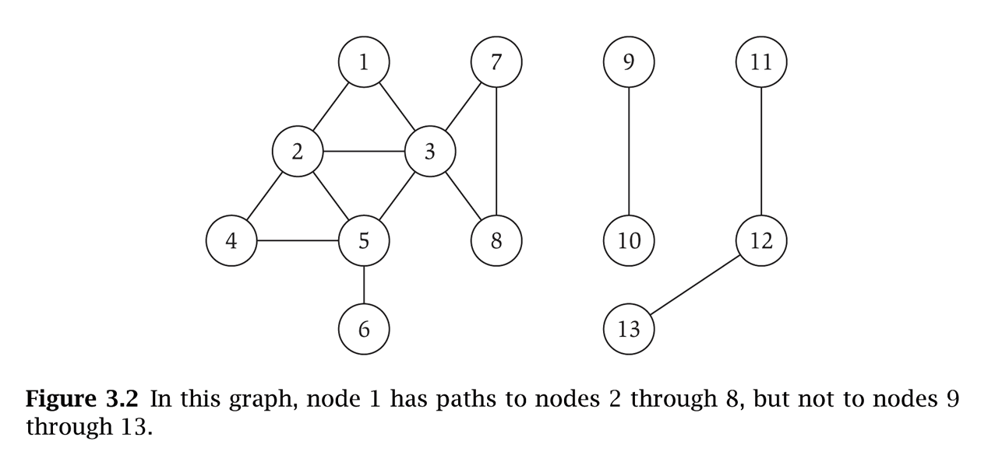
Graphs
Graph – mathematical object consisting of a set of:
V = nodes (vertices, points).
E = edges (links, arcs) between pairs of nodes.
Denoted by G = (V, E).
Captures pair wise relationship between objects.
Graph size parameters: n = |V|, m = |E|.
V = { 1, 2, 3, 4, 5, 6, 7, 8 }
E = { {1,2}, {1,3}, {2,3}, {2,4}, {2,5}, {3,5}, {3,7}, {3,8}, {4,5}, {5,6} } n = 8
m = 11

Slide 4
Graphs
Undirected Graph: A graph whose edges are unordered pairs of vertices. That is, each edge connects two vertices where edge (u, v) = edge (v, u).
Directed Graph: A graph whose edges are ordered pairs of vertices. That is, each edge can be followed from one vertex to another vertex where edge (u, v) goes from vertex u to vertex v.
Acyclic Graph: A graph with no path that starts and ends at the same vertex.
1
2
1
2
1
2
3
4
3
4
3
4
Directed
graph
Undirected
graph
Acyclic
graph

Slide 5
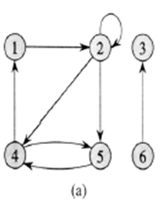
Graph Example
A directed graph G= (V, E), where V = {1, 2, 3, 4, 5, 6} and E={ (1,2), (2,2), (2,4), (2,5), (4,1), (4,5), (5,4), (6,3) }. The edge (2,2) is self loop. Vertex 5 has in-degree 2 and out-degree 1. Vertex 4 is adjacent to vertex 5; {1, 5} is adjacent to 4; 3 is not adjacent to any other vertex except 6.

Slide 6
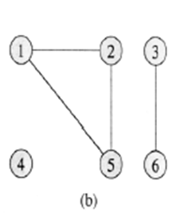
Graph Example
An undirected graph G = (V, E), where V = {1, 2, 3, 4, 5, 6} and E = { {1,2}, {1,5}, {2,5}, {3,6}}. The vertex 4 is isolated. Vertex 1, 2, 5 has degree 2; vertex 3, 6 has degree 1; vertex 4 has degree 0. Vertex 3 is adjacent to vertex 6 and vice versa; {1, 5} is adjacent to 2; 4 is not adjacent to any other vertex.

Slide 7
Graph Introduction
Complete graph: When every vertex is strictly connected to each other. (The number of edges in the graph is maximum).
Degree of a vertex v: The degree of vertex v in a graph G, written d (v ), is the number of edges incident to v, except that each loop at v counts twice (in-degree and out-degree for directed graphs)
_{A}
_{B}
_{F}
_{C}
_{E}
_{D}
d(A)=3, d(B)=3,d(C)=2
d(D)=3, d(E)=3,d(F)=2
Complete Graph

Slide 8
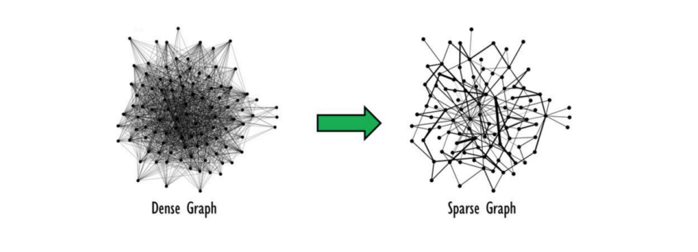
Graph Introduction
Dense graph: When the number of edges in the graph is close to maximum. (adjacency matrix is used to store info for this)
Sparse graph: When number of edges in the graph is very few. (adjacency list is used to store info for this)
Notes:
A dense graph is one where there are many edges, but not necessarily as many as in a complete graph. This term is intentionally vague and is intended to convey a general sense that the number of edges can be expected to be large with respect to the number of vertices.

Slide 9
Graph Introduction
Weighted graph: associates weights with either the edges or the vertices
DAG: Directed acyclic graphs
Connected: if every vertex of a graph can reach every other vertex, i.e., every pair of vertices is connected by a path
Strongly connected: every 2 vertices are reachable from each other (in a digraph)
Connected Component: equivalence classes of vertices under “is reachable from” relation. Simply put, it is a subgraph in which any two vertices are connected to each other by paths, and which is connected to no additional vertices in the supergraph.

Slide 10
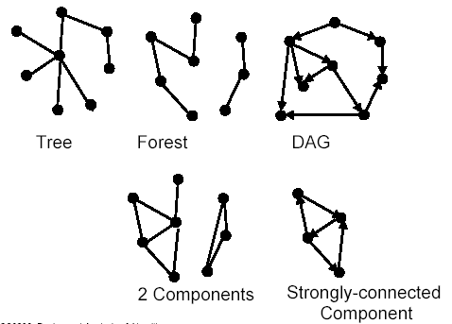
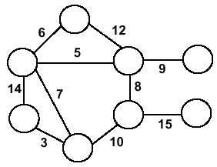
Forests, DAG, Components
Weighted Graph

Slide 11
Graph Applications
State-space search in Artificial Intelligence
Geographical information systems, electronic street directory
Logistics and supply chain management
Telecommunications network design
Many more industry applications
The graphic representation of world wide web (www)
Resource allocation graph for processes that are active in the system.
The graphic representation of a map
Scene graphs: The contents of a visual scene are also managed by using graph data structure.

Slide 12
Applications—Communication Network
2
3
8
1
10
4
5
9
11
6
7
Vertex = city, edge = communication link.

Slide 13
Applications—Driving Distance/Time Map
2
4
3
8
8
1
6
10
2
4
5
4
4
3
5
9
11
5
6
6
7
7
Vertex = city, edge weight = driving distance/time.

Slide 14
Applications—Street Map
2
3
8
1
10
4
5
9
11
6
7
Some streets are one way.

Slide 15
Graph Representation
Adjacency matrix: represents a graph as n x n matrix A (here, n is the number of nodes/ vertices):
A[i, j] = 1 if edge (i, j) ∈ E (or weight of edge)
= 0 if edge (i, j) ∉ E
Storage requirements: O(n²)
Using adjacency matrix is more efficient to represent dense graphs
Especially if store just one bit/edge
Undirected graph: only need half of matrix

Slide 16
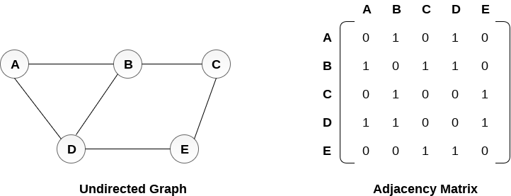
Graph Representation
(a)
(b)
a. An undirected graph G having five vertices and six edges.
b. The adjacency-matrix representation of G.

Slide 17
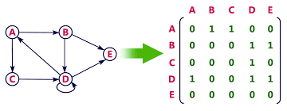
Graph Representation
(a)
(b)
a. A directed graph G having five vertices and eight edges.
b. The adjacency-matrix representation of G.

Slide 18
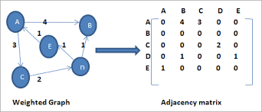
Graph Representation
(a)
(b)
a. A directed weighted graph G having five vertices and six edges.
b. The adjacency-matrix representation of G.

Slide 19
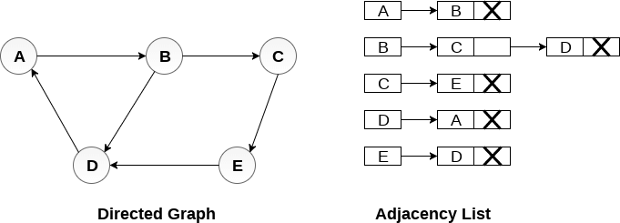
Graph Representation
Adjacency list: list of adjacent vertices. For each vertex v ∈ V, store a list of vertices adjacent to v
Storage requirements: O(n+e)
Using adjacency list is more efficient to represent sparse graphs
(a)
(b)
a. A directed graph G having five vertices and six edges.
b. The adjacency-list representation of G.

Slide 20
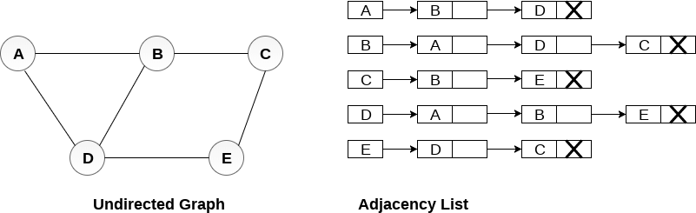
Graph Representation
(a)
(b)
a. An undirected graph G having five vertices and six edges.
b. The adjacency-list representation of G.

Slide 21
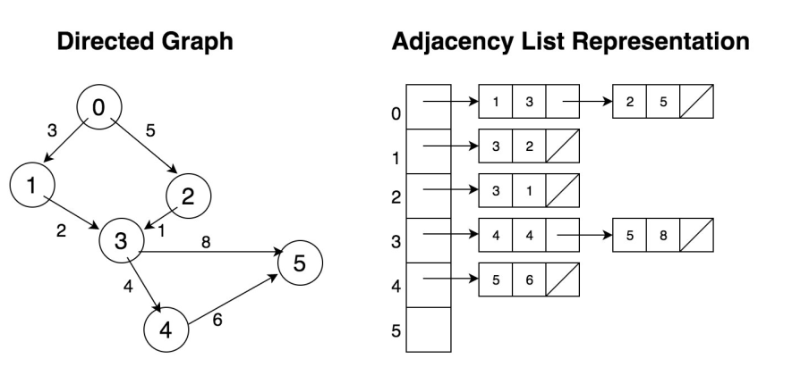
Graph Representation
(a)
(b)
a. A directed weighted graph G having six vertices and seven edges.
b. The adjacency-list representation of G.

Slide 22
Books
“Schaum's Outline of Data Structures with C++”. By John R. Hubbard (Can be found in university Library)
“Data Structures and Program Design”, Robert L. Kruse, 3rd Edition, 1996.
“Data structures, algorithms and performance”, D. Wood, Addison-Wesley, 1993
“Advanced Data Structures”, Peter Brass, Cambridge University Press, 2008
“Data Structures and Algorithm Analysis”, Edition 3.2 (C++ Version), Clifford A. Shaffer, Virginia Tech, Blacksburg, VA 24061 January 2, 2012
“C++ Data Structures”, Nell Dale and David Teague, Jones and Bartlett Publishers, 2001.
“Data Structures and Algorithms with Object-Oriented Design Patterns in C++”, Bruno R. Preiss,

Slide 23
References
https://en.wikipedia.org/wiki/Data_structure

